Slide 1

Starbucks Business Intelligence: Exploiting Data for Success
PROFESSOR - ERIC CLARK
TA -POOJA SURAPUR
By Group-5

Slide 2

Agenda
Introduction & current business model of starbucks
Overall Problem Statement and its causes.
Starbucks Overall Goal
Software tools used by Starbucks
Exploiting BI for Efficient Operations
Sources of data and its frequency
The Consumer of BI Insights of Starbucks
Recommendation to Improve Starbucks BI systems
Tableau Reports
Conclusion

Slide 3
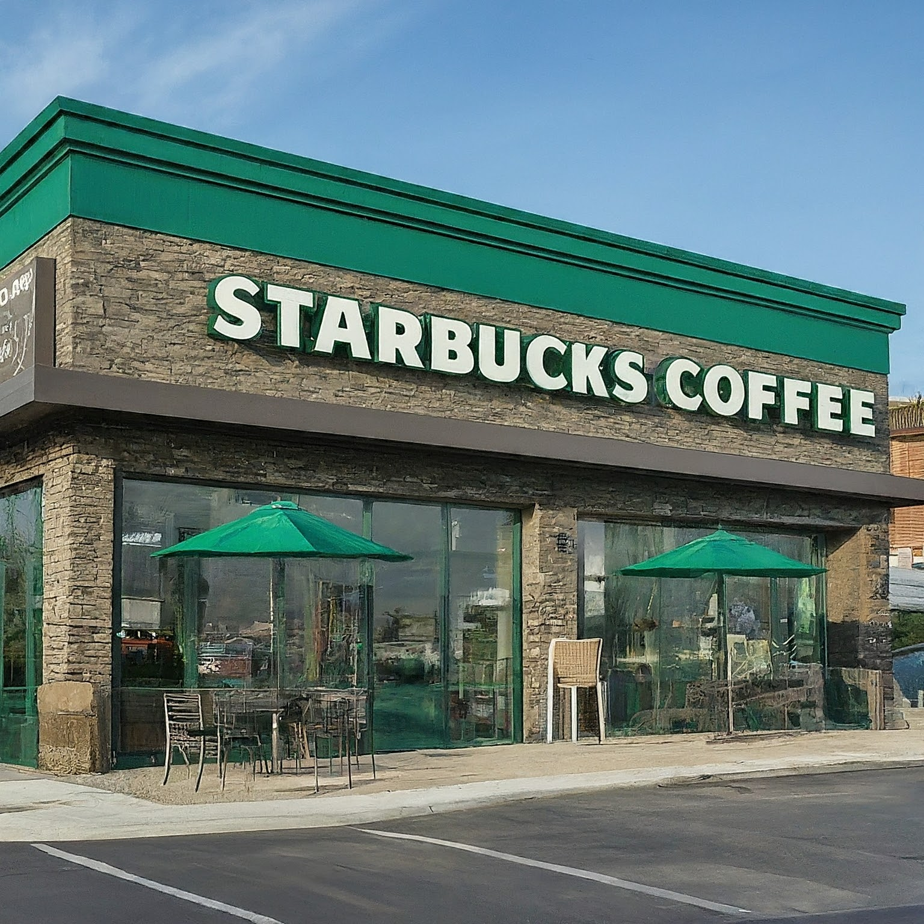
Introduction
Established in Seattle, Washington, in 1971
Worldwide chain of coffee shops with locations in more than 80 countries
known for its superior pastries, beverages, and coffee focused to sustainability and moral sourcing
Creative ideas such as Reserved Stands and Roasteries

Slide 4
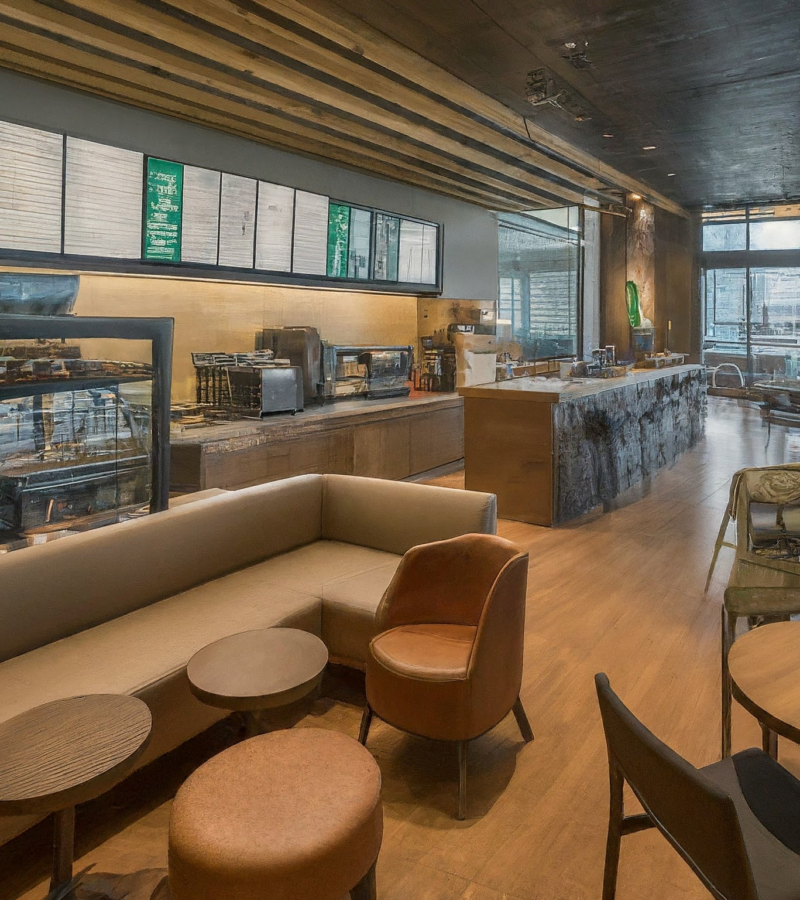
Current business Model
Mobile apps and digital innovation are highlighted
Give priority to contactless transactions and convenience.
Reducing emissions and waste as part of a sustainable commitment
Diversity, equity, and inclusion as a values-driven approach
making calculated risks in new product categories and markets

Slide 5
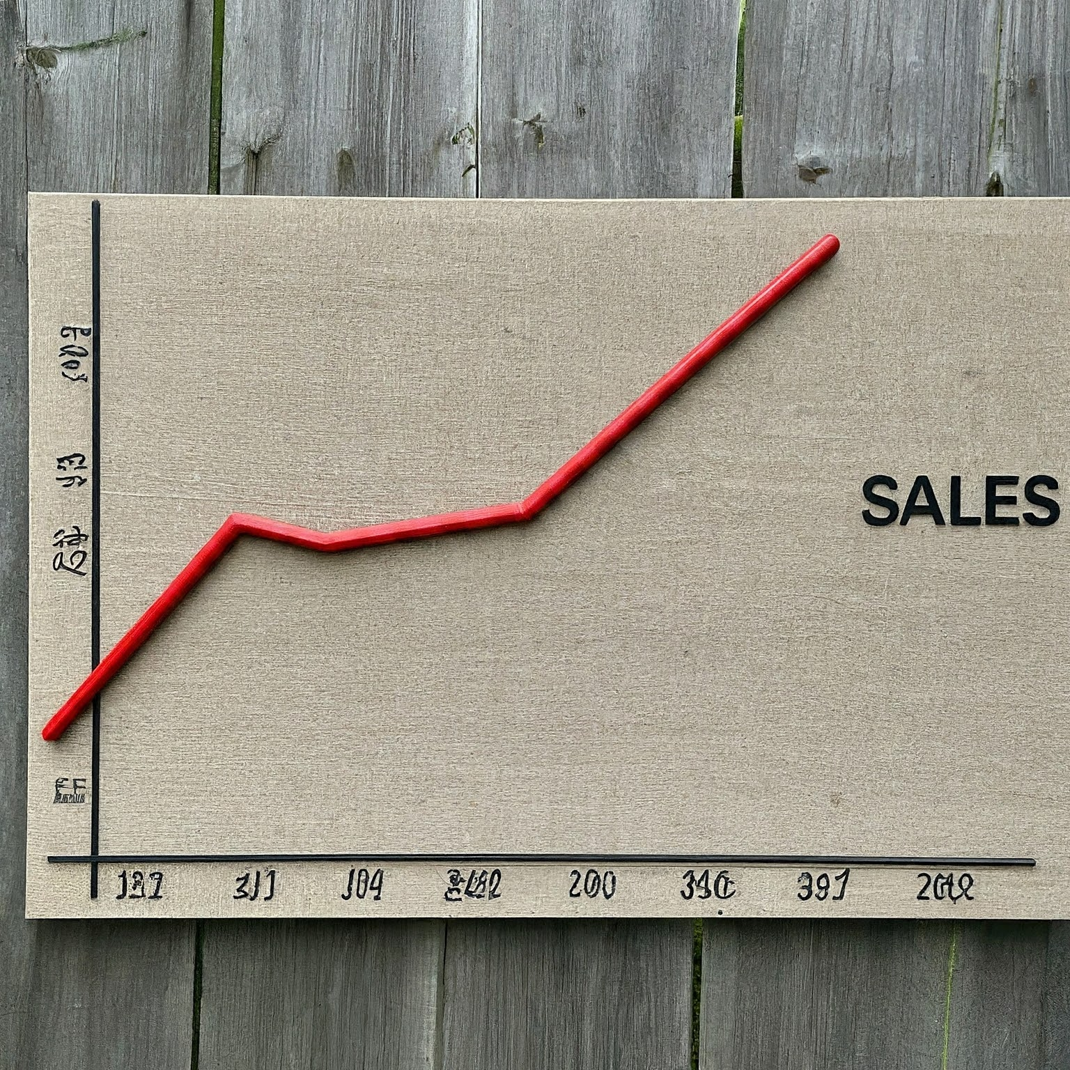
Overall Problems of Starbucks
Minimize stock waste and maximize sales performance
Increase sales of underperforming products
Improve overall profitability and operational efficiency
Data Integration
Real-Time Analytics
Customer Analytics
Global Economic Conditions

Slide 6
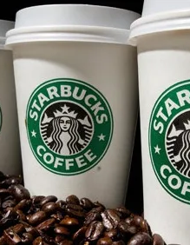
Causes of the Problem for Starbucks
Insufficient Advertising of the Product
Minimal Reach for Target Audience;
Absence of Product Innovation
Inadequate Stock Distribution
inadequate methods for inventory management
Supply Chain Disruptions
A lack of utilization of Technology
Market Competition

Slide 7
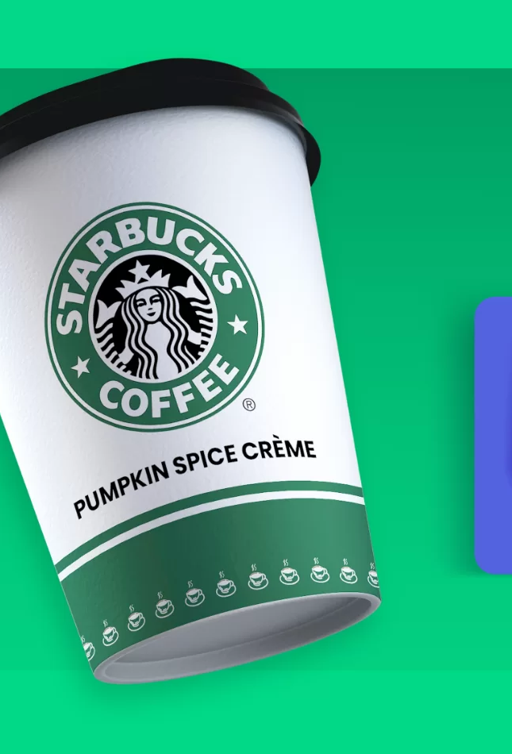
Starbucks Overall Goal
Putting Sustainable Packaging Solutions into Practice
Programs for Community Engagement: Neighborhood Projects and Volunteering
Open Sourcing: Fair Trade Policies, Ethical Handling of Coffee Growers
Initiatives for Diversity and Inclusion: Inclusive Work Culture, Equal Employment Opportunities
Innovation in Product Development: Introducing Specialty Beverages and Plant-Based Alternatives

Slide 8

Software Tools Utilized by Starbucks
SQL: Data queries and database management are done via Structured Query Language
Excel: A widely used program for reporting, processing, and visualizing data.
Tableau: An effective application for data visualization that lets you create intelligent reports and dashboards.
Python : Itis a flexible programming language used for machine learning, automation, and data analysis.
SAP: Software for enterprise resource planning (ERP) and business intelligence (BI).
Software for inventory management: Monitors stock levels and streamlines supply chain operations.
CRM: Marketing campaigns are personalized and consumer interactions are managed using customer relationship management, or CRM, software.
Financial software : It is used for transaction management, financial reporting, and budgeting.

Slide 9

Exploiting BI for Efficient Operations
Data Integration and Analysis: Analyzes and integrates data from multiple sources to provide a comprehensive picture.
Customer analytics: Examines consumer information to determine preferences and purchasing trends.
Supply chain optimization reduces waste by streamlining logistics and inventory levels.
Performance Monitoring: Real-time visibility into store performance indicators is made possible
Market intelligence : to carefully watch on rival activities and spots fresh openings of products.
Predictive analytics: predicts consumer behavior and future sales patterns.

Slide 10
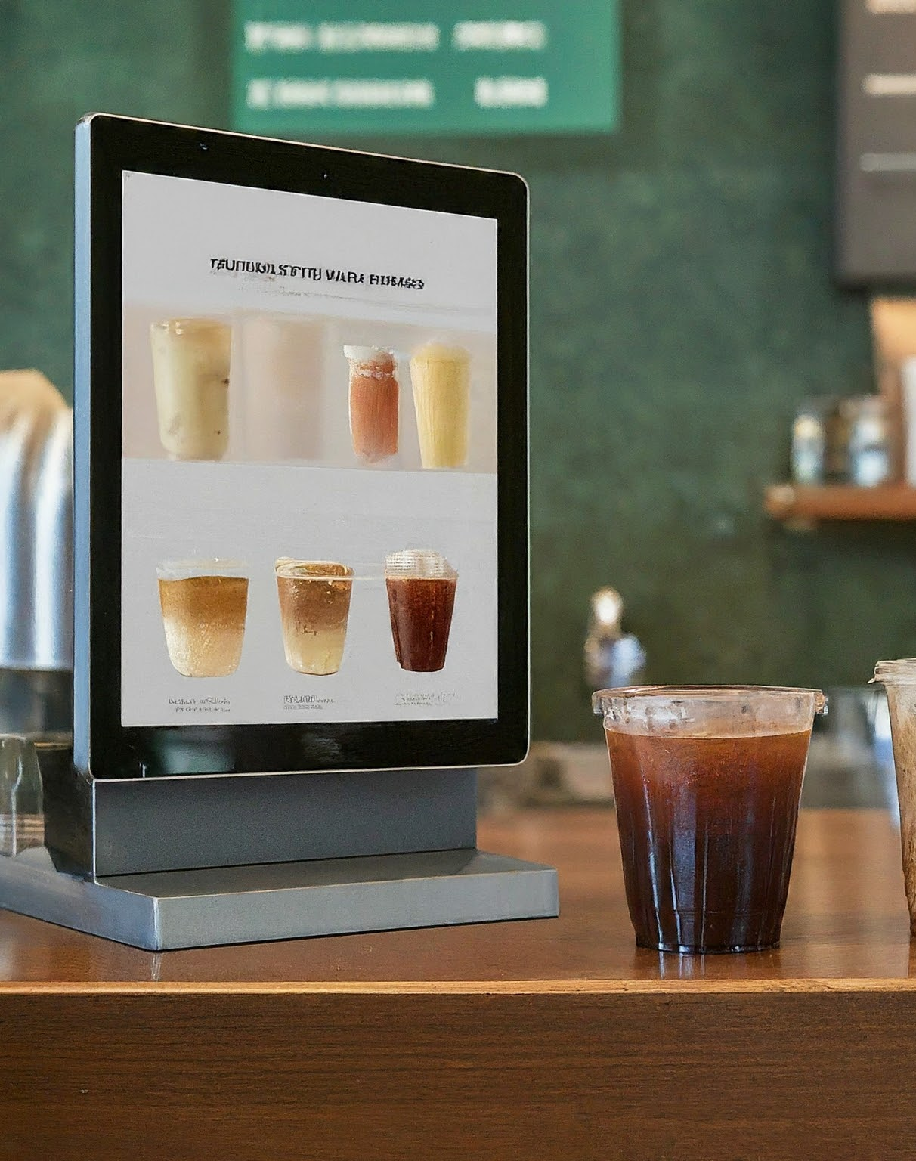
Sources of Data and its Frequency
Integration of Social Media Platforms, Mobile Apps, and IoT Sensor Data Streams
Constant Tracking of Sales Information: Hourly, Daily, Weekly Summaries
Acquiring Real-Time Input via Customer Surveys and Feedback Forms
Frequent Competitive Analysis and Market Research Studies

Slide 11
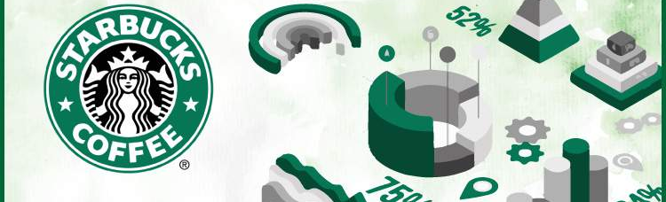
The Consumer of BI Insights of Starbucks
Making strategic decisions and increases operational efficiency through the use of BI.
Uses business intelligence to track and assess sustainability initiatives.
Utilizes BI data to modify seasonal meals.
Uses BI to customize promotions and reward schemes.
Improving the Mobile Ordering Experience with Recommendations Driven by Big Data

Slide 12

Recommendation to Improve Starbucks BI Systems
Capabilities for real-time data streaming and in-memory processing provide for quicker insights.
Managers may make prompt decisions by using real-time data when they have mobile access to their dashboards.
For deeper insights, use predictive modeling and machine learning in advanced analytics.
Keep an eye on ongoing improvement: Assess and improve BI systems on a regular basis to meet changing requirements.

Slide 13
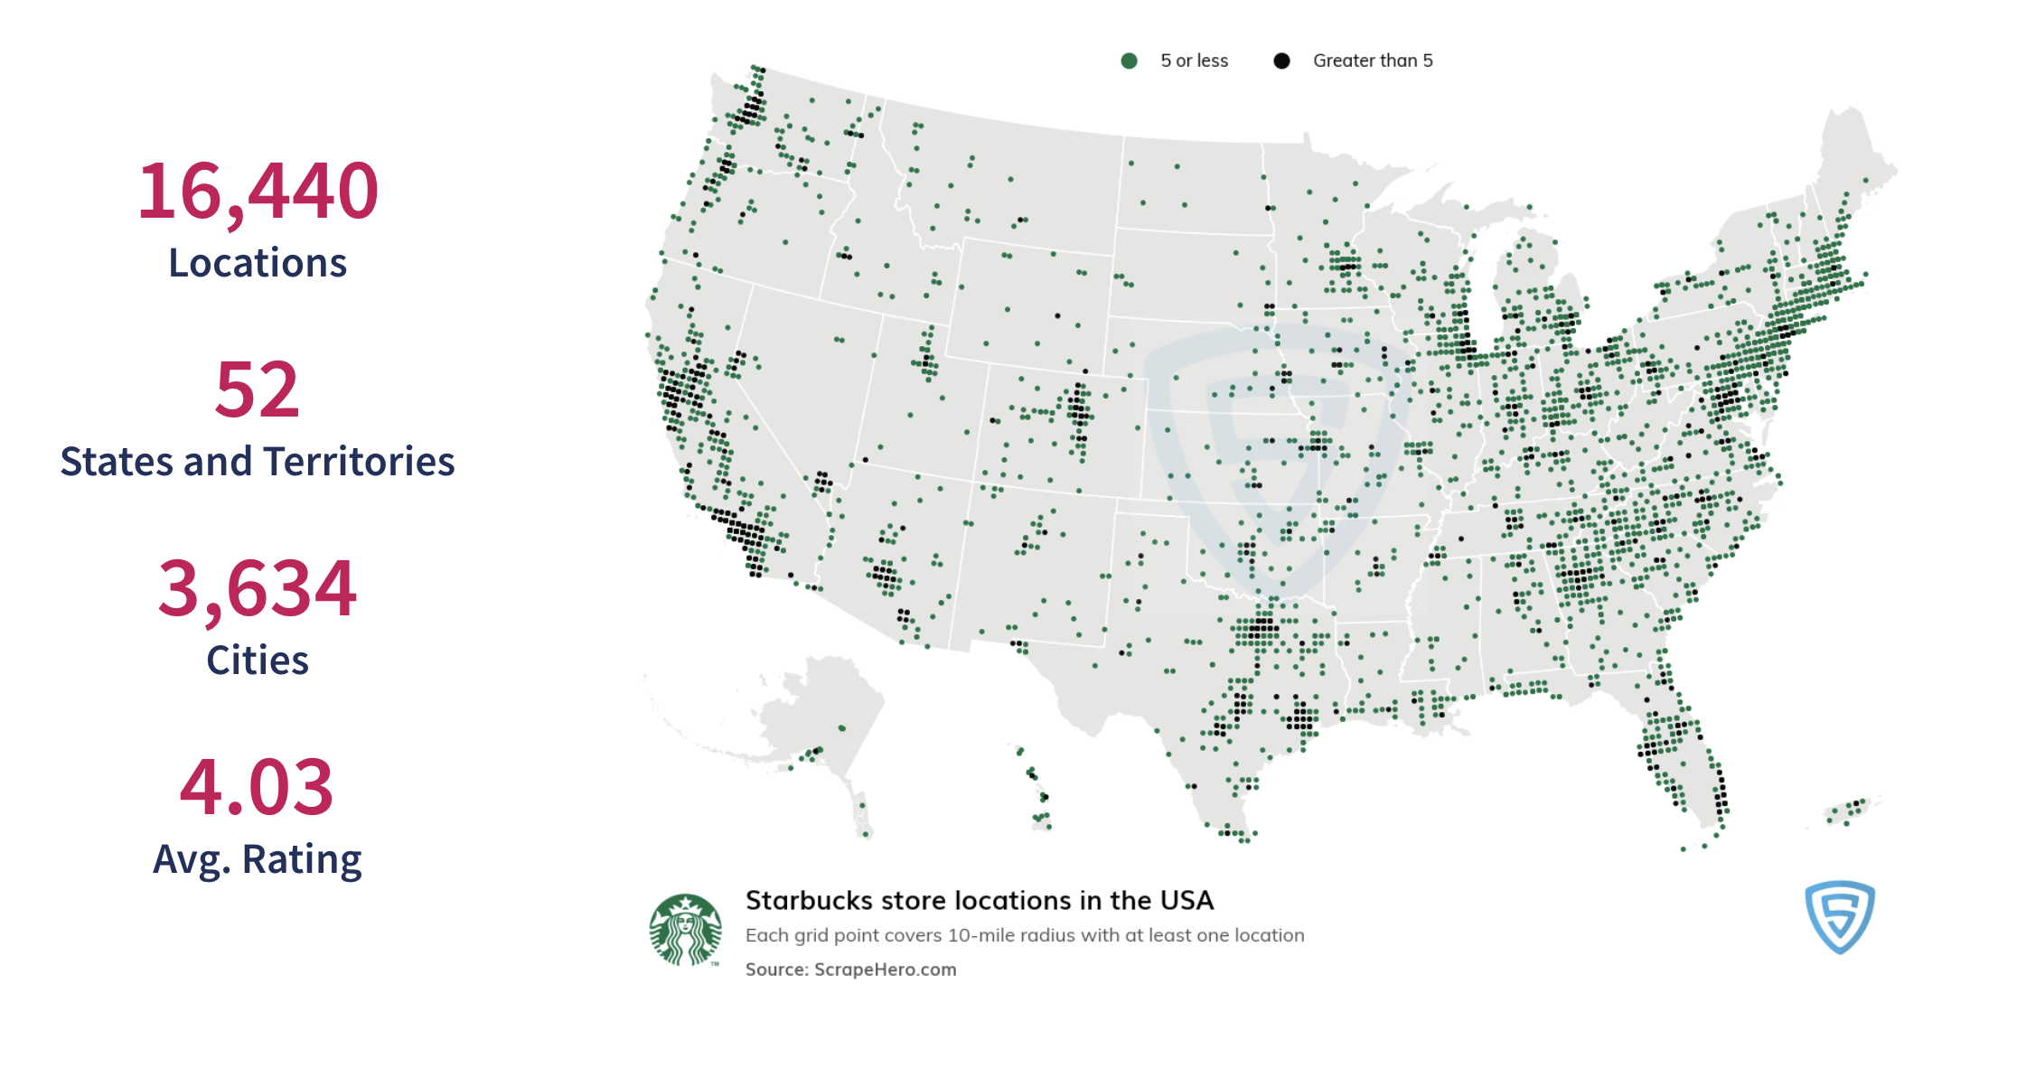
Starbucks store locations in USA:

Slide 14
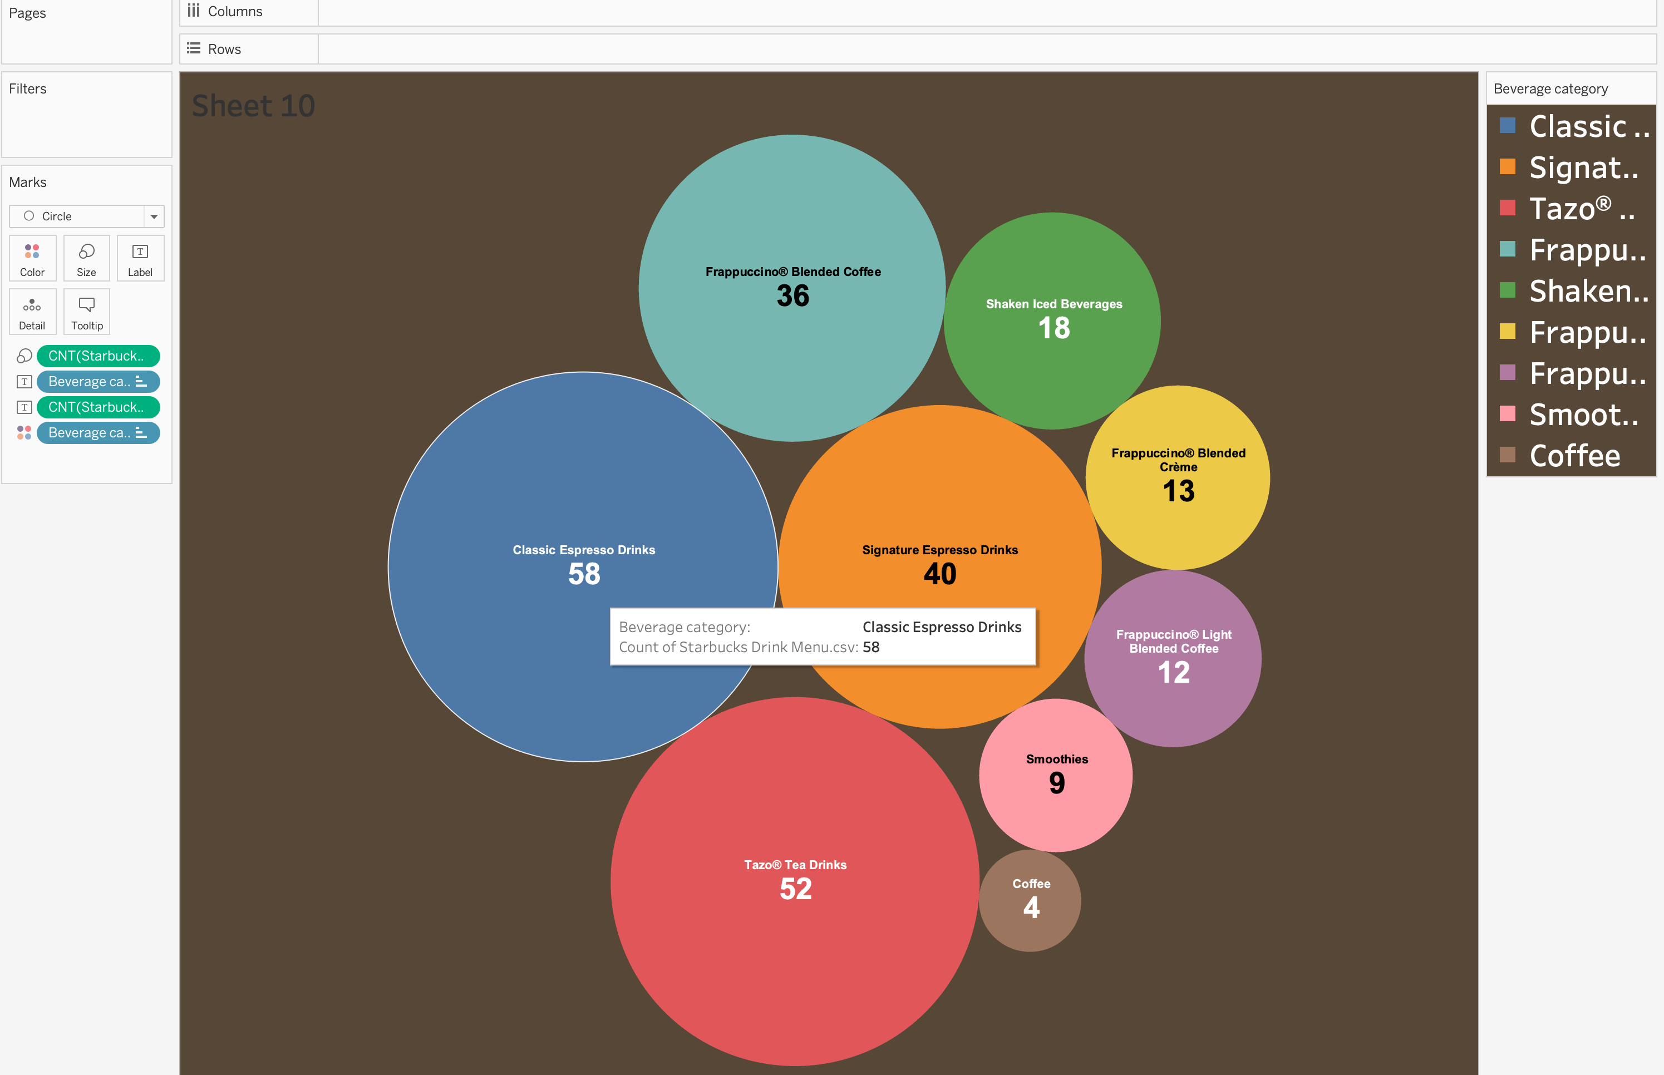
Starbucks Beverage Category and its count in the menu:

Slide 15
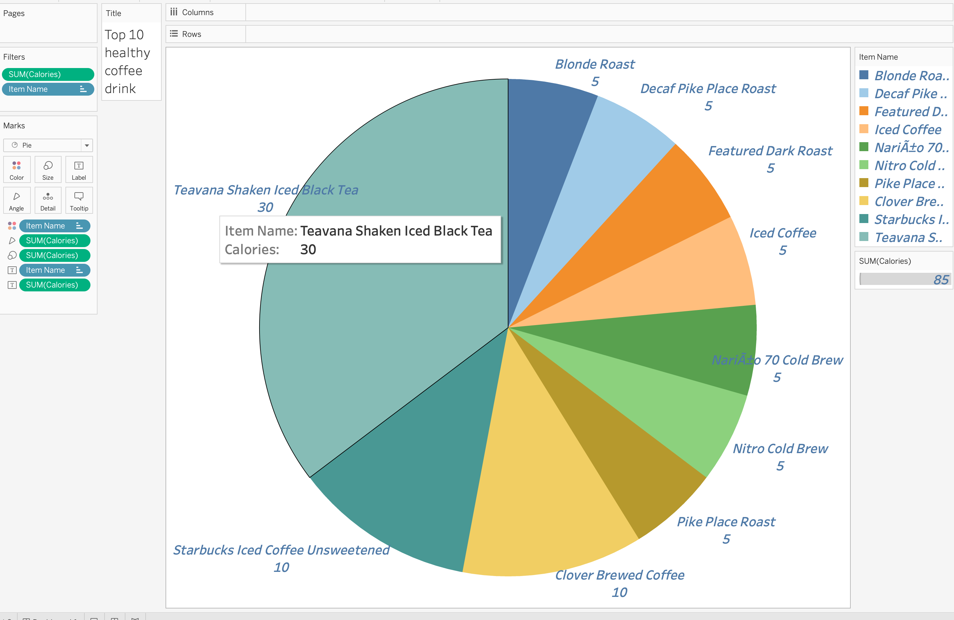
Top 10 healthy coffee drinks at Starbucks:

Slide 16
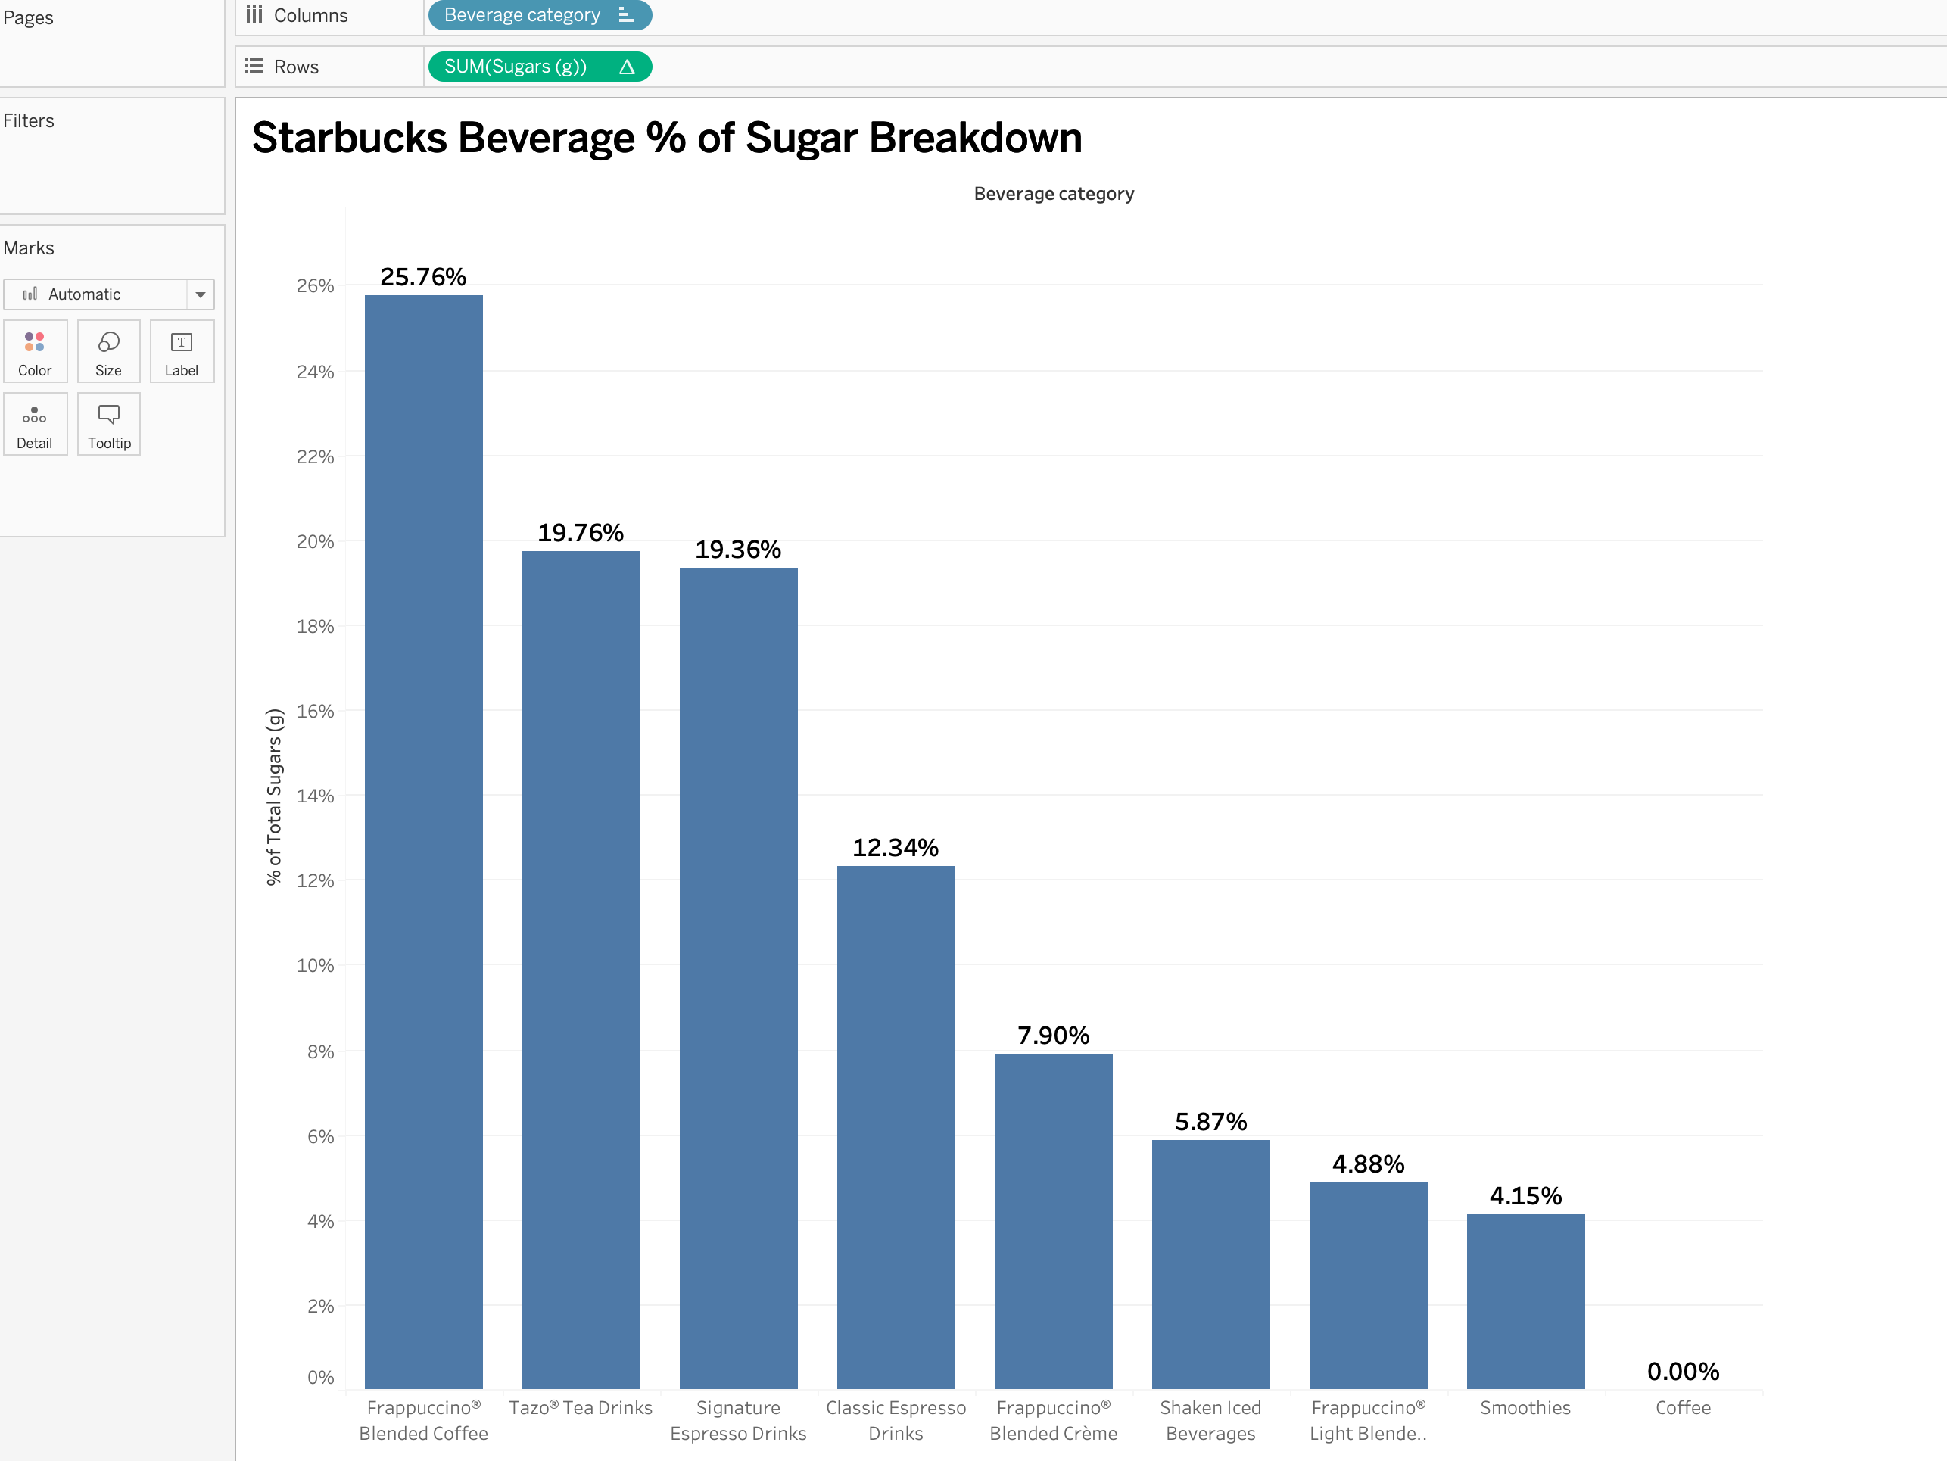
Starbucks Beverage % of Sugar breakdown:

Slide 17
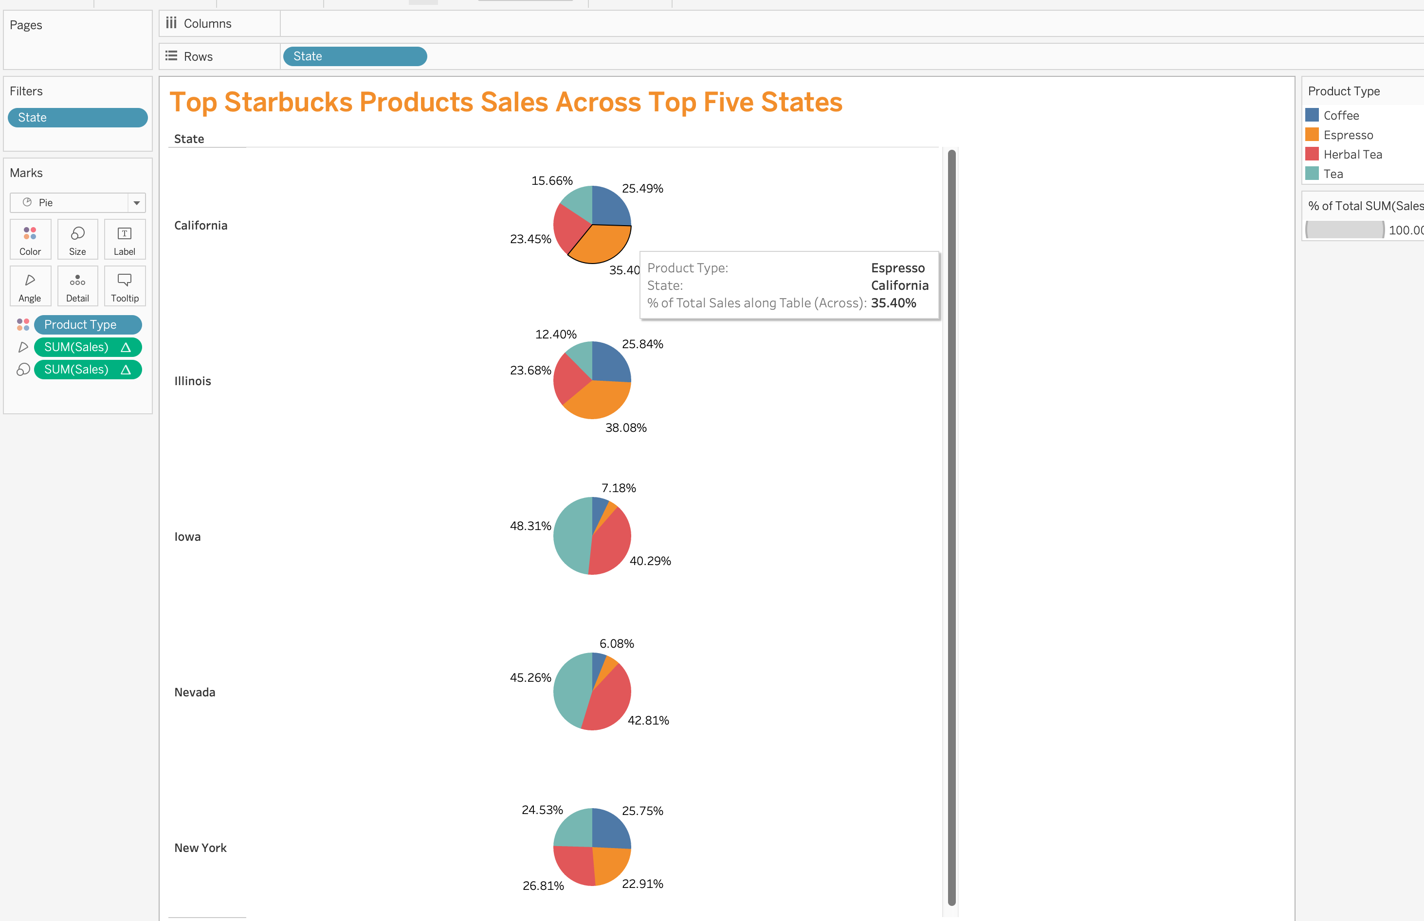
Top Starbucks Products Sales Across Top Five States in USA

Slide 18
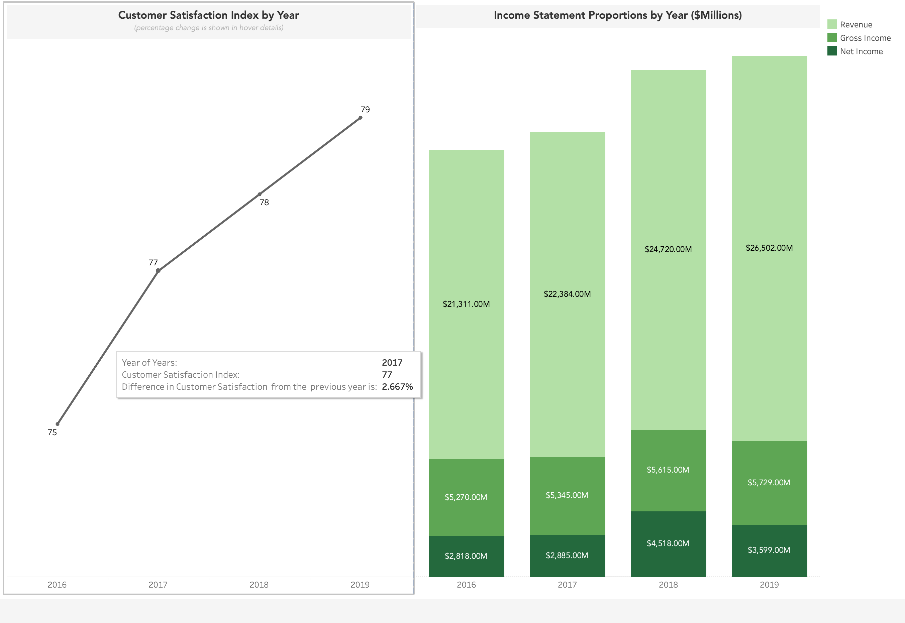
Starbucks Performance Dashboard In USA:
Starbucks performance dashboard

Slide 19
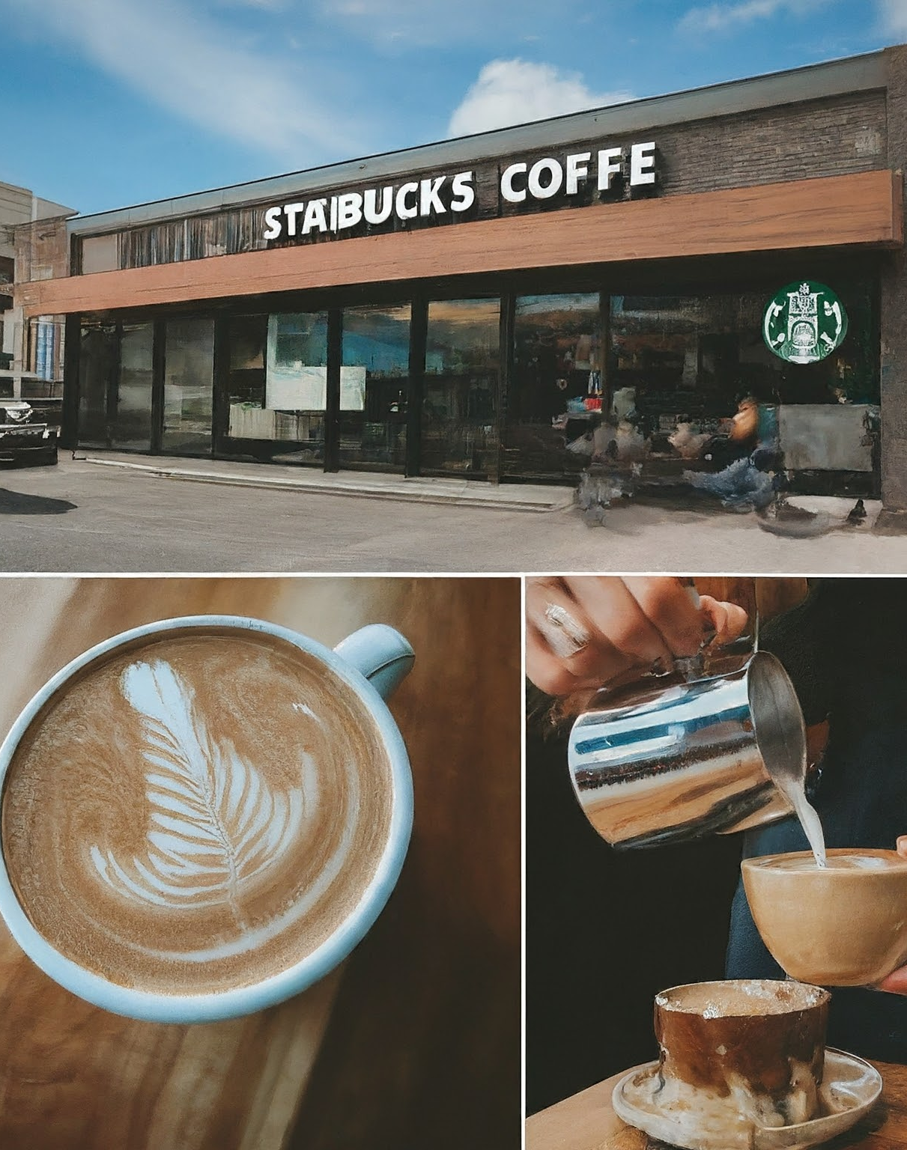
Conclusion
Starbucks uses BI to extract insightful information from data.
Starbucks uses business intelligence (BI) to streamline processes, customize the customer experience, and meet sustainability targets.
For Starbucks to maintain its lead in the cutthroat coffee market, BI systems must be improved continuously.
Starbucks may achieve even greater growth and success by integrating cutting-edge technology like artificial intelligence and machine learning.

Slide 20

Starbucks

